Slide 1

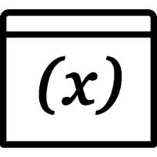
Variables and Data Types
Introduction to Computer Science
Workshop, RUNI
Workshop 2
Notes:
‹#›

Slide 2
Today
Variables
Types of variables
Notes:
‹#›

Slide 3
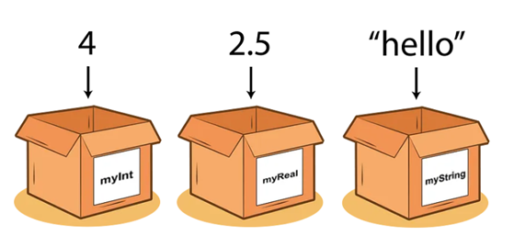
Variables
Variables are containers for storing data values | Data is given either as input, or calculated by the program | To access it later, data must be remembered
Computer programs manipulate data | We use variables to store data in the memory
Each variable has a…
value (content, the stored data)
name (a shortcut to its address in memory)
type (str, int, float, bool)
Notes:
‹#›

Slide 4
Variables
In Java we create variables simply by specifying the type and assign a value to a variable name:
int myNum = 4;
double myDoubleNum = 2.5;
String name = “David”;
In Java you can also declare a variable without assigning the value, and assign the value later:
int myNum;
myNum = 15;
Java follows the camelCase syntax for naming variables.
Notes:
‹#›

Slide 5
Types of Variables
Integers
Maximum Value | Minimum Value | Type
127 | -128 | byte
32767 | -32,768 | short
2,147,483,647 | -2,147,483,648 | int
9,223,372,036,854,775,807 | -9,223,372,036,854,775,808 | long
Represent “whole” numbers.
Notes:
‹#›

Slide 6
Types of Variables
Real Numbers
Have two types:
float
double
The only difference between types is precision.
Since double is more precise, we will only use that type.
Notes:
‹#›

Slide 7
Types of Variables
Logical Variables
‘boolean’ type.
Can have only two values: ‘true’ or ‘false’
Uses the logical operators : ‘and’, ‘or’ and ‘not’
Description | Name | Operator
‘true’ if both x and y are true, otherwise ‘false’. | and | x && y
‘true’ if either x or y are true (or both), otherwise ‘false’. | or | x || y
‘true’ if x is false, otherwise ‘false’. | not | !x
Notes:
‹#›
אפשר בתכנית שלנו ממש להשתמש בערכים true ו false

Slide 8
Types of Variables
Characters Variables
‘char’ type.
Holds the value of a single character or “letter”.
The value assigned needs to be between single quotes.
Java supports a small set of special characters
Examples:
char a = ‘a’;
char b = ‘\b’;
Description | Character
Backspace | \b
Tab | \t
New line | \n
Double quote | \”
Single quote | \’
Notes:
‹#›

Slide 9
Types of Variables
Strings
A String is a sequence of characters.
String a = “This is a string”;
String b = “1”;
String c = “true”;
Different Strings can be concatenated using the ‘+’ operator. Resulting in joining their characters end-to-end.
String a = “Introduction to “;
String b = “Computer Science”;
System.out.println (a + b) // what will be printed?
Notes:
‹#›
מחרוזות שני צופציקים
מה יודפס Introduction to Computer Science

Slide 10
Question 1
public class Main {
public static void main(String[] args) {
int x = 2;
int y = x;
x = x + 1;
System.out.println(x);
System.out.println(y);
}
}
1.1 What is the output?
1.2 Does the second assignment to x change y’s value?
Notes:
‹#›

Slide 11
Question 2
Write a simple Java program that swaps the values of two integer variables without using any operations, or losing data.
Example:
if a=5 and b=7 in the start of the program.
by the end of the program a=7, b=5;

Slide 12
Question 2: Strategy Illustration
Step 1: initial declaration of ‘a’ and ‘b’
Step 2: declaration of ‘temp’ and give it the initial value stored in ‘a’
Step 3: reassign the value of variable ‘a’ to be the value store in variable ‘b’
Step 4: reassign b’s value to be a copy of b
variable name: a
variable original value: 5
variable current value: 7
changed after step: 3
variable name: b
variable original value: 7
variable current value: 5
changed after step: 4
step 3
step 2
step 4
variable name: temp
variable value: 5

Slide 13
Question 2: Solution
/*
* This program initializes two integers with arbitrary
* values then flips their values. Meaning, the first
* variable will now have the value of the second variable
ֿ* and vice versa.
*/
public class FlipFlop {
public static void main(String[] args){
int a = 5;
int b = 7;
int temp = a;
a = b;
b = temp;
}
}
Notes:
‹#›

Slide 14
Question 2
public class Main {
public static void main(String[] args) {
int x = 2;
int y = x;
x = x + 1;
System.out.println(x);
System.out.println(y);
}
}
1.1 What is the output?
1.2 Does the second assignment to x change y’s value?
Notes:
‹#›
מחרוזות שני צופציקים

Slide 15
Type Conversion
Notes:
‹#›

